Slide 1
UNIT-2
Machine learning classifiers

Slide 2
Motivation: When One Variable Is Not Enough
When dealing with complex systems or phenomena, using only one variable may not be sufficient to capture the full picture or provide a comprehensive understanding. There are several reasons why one variable might not be enough:
Incomplete Representation: A single variable may oversimplify the situation and fail to account for all relevant factors. Complex phenomena often involve multiple interacting components, and reducing them to just one variable may result in a loss of important information.
Multifaceted Nature: Many real-world phenomena have multiple dimensions or aspects that influence their behavior. Using only one variable might overlook these other dimensions, leading to an incomplete analysis.
Interconnected Variables: Variables in a system are often interconnected, meaning changes in one variable can impact others. Focusing on only one variable may miss the dynamic relationships and interactions occurring within the system.
Non-linear Relationships: Some relationships between variables are non-linear, meaning the impact of changes in one variable is not proportional or constant. A single variable analysis may miss these intricate patterns.
Context Dependency: The significance of a variable may depend on the context. A variable that seems crucial in one situation may be less relevant in another. Ignoring context can lead to oversights and misinterpretations.
Emergent Properties: In complex systems, new properties and behaviors can emerge from the interactions of multiple variables. Focusing on a single variable may not capture these emergent properties.
Feedback Loops: Systems often involve feedback loops where the output of a process influences the input. Understanding these feedback loops requires considering multiple variables simultaneously.

Slide 3
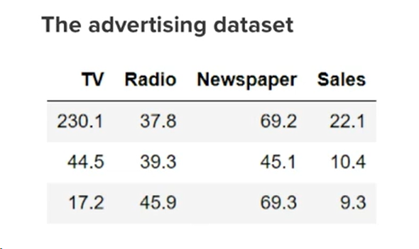
Example:

Slide 4
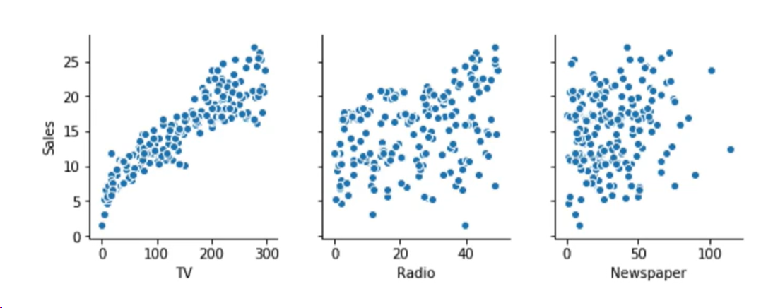

Slide 5
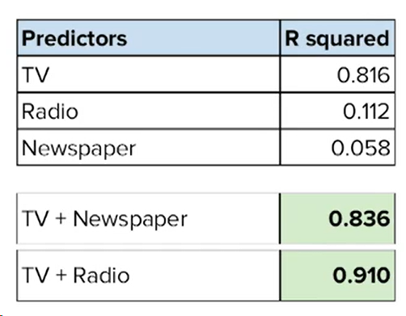

Slide 6
Choosing a Classification Algorithm: Classification algorithm is opted on following aspects:
Data characteristics
Problem complexity
Model performance
Model interpretability
Model scalability
Model flexibility

Slide 7
1. Data characteristics
The first thing to look at is the characteristics of your data, such as the number of features, the distribution of classes, the type and scale of the variables, and the presence of noise or outliers.
Different algorithms have different assumptions and requirements about the data, so you need to check if your data meets them or if you need to transform or preprocess it further.
For example, some algorithms, such as logistic regression or support vector machines, work better with numeric and standardized data, while others, such as decision trees or random forests, can handle categorical and ordinal data.

Slide 8
2. Problem complexity
The next thing to consider is the complexity of your classification problem, such as the number of classes, the degree of overlap or separability, and the type of decision boundary.
Different algorithms have different capabilities and limitations in dealing with complex problems, so you need to evaluate how well they can capture the patterns and relationships in your data.
For example, some algorithms, such as k-nearest neighbors or neural networks, can handle nonlinear and high-dimensional problems, while others, such as naive Bayes or linear discriminant analysis, assume linear or simple dependencies.

Slide 9
3. Model performance
The third thing to consider is the performance of your classification model, such as the accuracy, precision, recall, and f1-score.
Different algorithms have different strengths and weaknesses in predicting different classes, so you need to measure and compare how well they perform on your data.
For example, some algorithms, such as gradient boosting or ensemble methods, can achieve high accuracy and robustness, while others, such as knn or neural networks, can be sensitive to overfitting or underfitting.

Slide 10
4. Model interpretability
The fourth thing to consider is the interpretability of your classification model, such as the transparency, explainability, and understandability of the results.
Different algorithms have different levels of complexity and abstraction, so you need to assess how easy or difficult it is to explain and understand how they work and why they make certain predictions.
For example, some algorithms, such as decision trees or logistic regression, can provide clear and intuitive rules or coefficients, while others, such as neural networks or support vector machines, can be opaque and hard to interpret.

Slide 11
5. Model scalability
The fifth thing to consider is the scalability of your classification model, such as the speed, efficiency, and resource consumption of the training and testing process.
Different algorithms have different computational and memory requirements, so you need to estimate how fast or slow they can handle large or small datasets.
For example, some algorithms, such as naive Bayes or linear discriminant analysis, can be fast and simple to train and test, while others, such as neural networks or support vector machines, can be slow and complex to train and test.

Slide 12
6. Model flexibility
The sixth thing to consider is the flexibility of your classification model, such as the adaptability, customization, and generalization of the parameters and settings.
Different algorithms have different degrees of freedom and constraints, so you need to explore how much or how little you can adjust and optimize them to suit your data and problem.
For example, some algorithms, such as decision trees or neural networks, can offer many options and variations, while others, such as logistic regression or support vector machines, can have fewer options and variations.

Slide 13
First Steps with Scikit-Learn:
Scikit-learn is a popular open source Python library for machine learning. Some key reasons for its widespread use include:
Simple and efficient tools for data analysis and modeling
Accessible to Python programmers, with focus on clarity
Built on NumPy, SciPy and matplotlib for easier integration
Wide range of algorithms for tasks like classification, regression, clustering, dimensionality reduction

Slide 14
Step 1: Getting Started with Scikit-learn:
Scikit-learn can be installed using pip, Python's package manager:
pip install scikit-learn
This will also install any required dependencies like NumPy and SciPy. Once installed, Scikit-learn can be imported in your Python scripts as follows:
Import sklearn
Loading Sample Datasets: Scikit-learn provides a variety of sample datasets that we can use for testing and experimentation:
from sklearn import datasets
iris = datasets.load_iris()
digits = datasets.load_digits()
-> The digits dataset contains images of handwritten digits along with their labels.

Slide 15
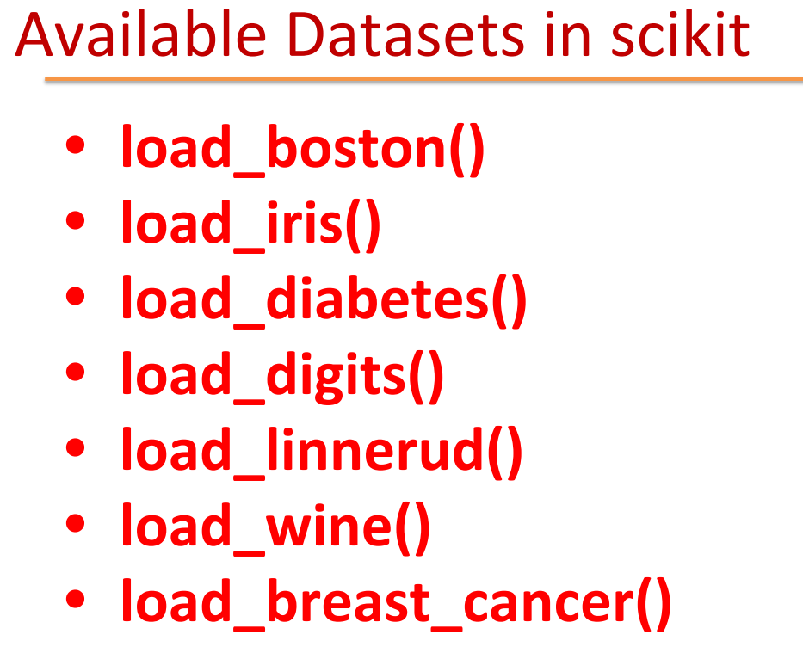

Slide 16
Step 2: Data Preprocessing
Data Cleaning: Real data often contains missing, corrupt or outlier values. Scikit-learn provides tools to handle these issues:
from sklearn.impute import SimpleImputer
imputer = SimpleImputer(strategy='mean’)
imputed_data = imputer.fit_transform(iris_data.data)
The imputer replaces missing values with the mean, which is a common — but not the only — strategy. This is just one approach for data cleaning.
Feature Scaling: Algorithms like Support Vector Machines (SVMs) and neural networks are sensitive to the scale of input features.
Inconsistent feature scales can result in these algorithms giving undue importance to features with larger scales, thereby affecting the model's performance.
Therefore, it's essential to normalize or standardize the features to bring them onto a similar scale before training these algorithms.

Slide 17
from sklearn.preprocessing import StandardScaler
scaler = StandardScaler()
scaled_data = scaler.fit_transform(iris_data.data)
StandardScaler standardizes features to have mean 0 and variance 1.
Visualizing the Data:
import matplotlib.pyplot as plt
plt.scatter(iris_data.data[:, 0], iris_data.data[:, 1], c=iris_data.target)
plt.xlabel('Sepal Length’)
plt.ylabel('Sepal Width') plt.show()
Why data visualization is important?
It allows you to spot underlying patterns and trends in the data, identify outliers that may skew model performance, and gain a deeper understanding of the relationships between variables.
By visualizing the data beforehand, you can make more informed decisions during the feature selection and model training phases.

Slide 18
Step 3: Model Selection and Training:
Scikit-learn provides a variety of supervised and unsupervised algorithms:
Classification: Logistic Regression, SVM, Naive Bayes, Decision Trees, Random Forest
Regression: Linear Regression, SVR, Decision Trees, Random Forest
Clustering: k-Means, DBSCAN, Agglomerative Clustering

Slide 19
Choosing an Algorithm:
Choosing the most appropriate machine learning algorithm is vital for building high quality models. The best algorithm depends on a number of key factors:
The size and type of data available for training. Is it a small or large dataset? What kinds of features does it contain - images, text, numerical?
The available computing resources. Algorithms differ in their computational complexity. Simple linear models train faster than deep neural networks.
The specific problem we want to solve. Are we doing classification, regression, clustering, or something more complex?

Slide 20
Training a Simple Model:
from sklearn.linear_model import LogisticRegression
model = LogisticRegression()
model.fit(scaled_data, iris_data.target)
That's it! The model is trained and ready for evaluation and use.
Training a More Complex Model:
from sklearn.ensemble import RandomForestClassifier
rf_model = RandomForestClassifier(n_estimators=100)
rf_model.fit(scaled_data, iris_data.target)

Slide 21
Step 4: Model Evaluation:
Train/Test Split: We split the data to evaluate model performance on new data:
from sklearn.model_selection import train_test_split
X_train, X_test, y_train, y_test = train_test_split(scaled_data, iris_data.target)
By convention, X refers to features and y refers to target variable. Please note that y_test and iris_data.target are different ways to refer to the same data.
Evaluation Metrics: For classification, key metrics include:
Accuracy: Overall proportion of correct predictions
Precision: Proportion of positive predictions that are actual positives
Recall: Proportion of actual positives predicted positively
These can be computed via Scikit-learn's classification report:
from sklearn.metrics import classification_report
print(classification_report(y_test, model.predict(X_test)))

Slide 22
Step 5: Improving Performance:
Hyperparameter Tuning:
Hyperparameters are model configuration settings. Tuning them can improve performance:
from sklearn.model_selection import GridSearchCV
params = {'C': [0.1, 1, 10]}
grid_search = GridSearchCV(model, params, cv=5)
grid_search.fit(scaled_data, iris_data.target)
This grids over different regularization strengths to optimize model accuracy.
Cross-Validation: Cross-validation provides more reliable evaluation of hyperparameters:
from sklearn.model_selection import cross_val_score
cross_val_scores = cross_val_score(model, scaled_data, iris_data.target, cv=5)
It splits the data into 5 folds and evaluates performance on each.

Slide 23
Perceptron Classifier:
Perceptron is Machine Learning algorithm for supervised learning of various binary classification tasks.
Perceptron model is also treated as one of the best and simplest types of Artificial Neural networks.
However, it is a supervised learning algorithm of binary classifiers. Hence, we can consider it as a single-layer neural network with four main parameters, i.e., input values, weights and Bias, net sum, and an activation function.

Slide 24
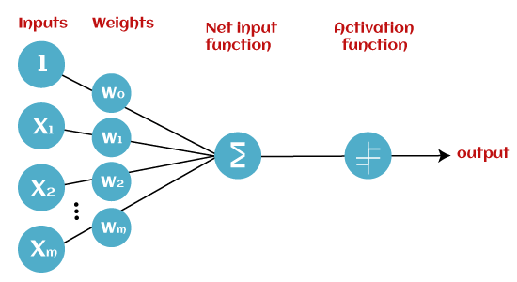
Basic Components of Perceptron

Slide 25
Input Nodes or Input Layer:
This is the primary component of Perceptron which accepts the initial data into the system for further processing. Each input node contains a real numerical value.
Weight and Bias:
Weight parameter represents the strength of the connection between units. This is another most important parameter of Perceptron components. Weight is directly proportional to the strength of the associated input neuron in deciding the output. Further, Bias can be considered as the line of intercept in a linear equation.
Activation Function:
These are the final and important components that help to determine whether the neuron will fire or not. Activation Function can be considered primarily as a step function.

Slide 26
Activation Function
Here the activation function used is the step function.
It sees if the summation is more than equal to calculated Threshold value , if yes then neuron should fire (i.e. output =1
) if not the neuron should not fire (i.e. output =0).
Neuron fires: Output =1 ,
if Summation(Inputs*Weights) >= Threshold
Neuron does not fire: Output =0 , if Summation(Inputs*Weights) < Threshold

Slide 27
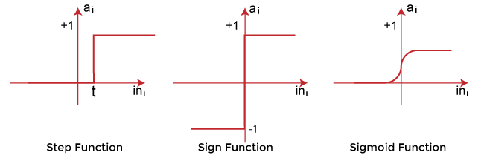
Types of Activation functions:
Sign function
Step function, and
Sigmoid function

Slide 28
How Perceptron Model works:
The input data is enabled into the Perceptron.
Apply dot product between input & it’s respective weights and sum them up.
Apply step function on above summation –
If output of step function >= 0 then perceptron is fired, output = 1
If output of step function < 0 then perceptron does not fire, output = 0

Slide 29
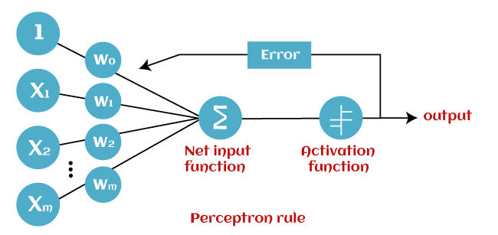

Slide 30
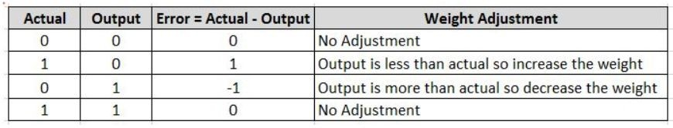
Training a Perceptron
Learning Parameters:
Machine learning models have parameters whose optimal value it learns during the training phase.
In a Perceptron the parameters that are learned during training phase are –
Weights of input parameters
bias
Threshold value
Errors and Weight adjustment:
During training phase, the weights are initialized randomly and with each data, the error is calculated and weights are adjusted accordingly so as to reduce the error.
As you have seen above, the possible output of perceptron is only binary i.e 0 or 1. So there are only four possible combination of actual value and output value.
Below chart shows this combination and will help you to get intuition how weights should be adjusted in case of error.

Slide 31
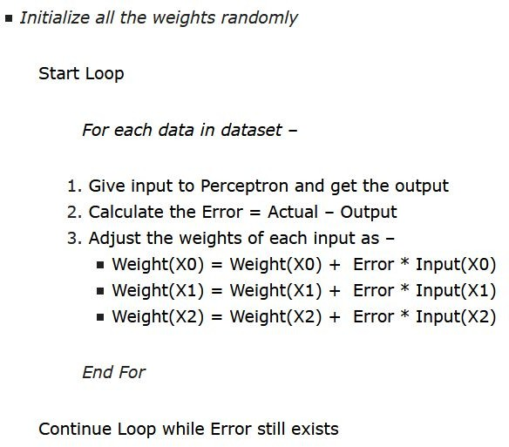
Perceptron Learning Algorithm
Let us first see the pseudo code of this algorithm with respect to our example in above animation.

Slide 32
Intuition behind Perceptron Learning Algorithm
For most part of the pseduo code, things should be self explanatory.
We are doing multiple loops over dataset and in each loop we are passing data one by one through perceptron, calculating error and adjusting weights.
The loop is continued till there are no errors.
Example 1:
– Actual =1 , Output =0, Error =1
In this case, since Output is less than actual, we would like to increase the weight to push the output towards actual. It requires a positive weight adjustment
Weight = Weight + Error*Input = Weight + 1*Input (weight adjustment is positive)
Example 2:
– Actual =0 , Output =1, Error = -1
In this case, since Output is more than actual, we would like to decrease the weight to pull back the output towards actual. It requires a negative weight adjustment
Weight = Weight + Error*Input = Weight – 1*Input (weight adjustment is negative)
Example 3:
– Actual =0 , Output =0, Error =0
In this case since Output and Actual is same, there is no error so zero weight adjustment is required.
Weight = Weight + Error*Input = Weight – 0*Input = Weight (no weight adjustment)

Slide 33
Numerical: AND function using Perceptron
Training Data:
X0=1
x1
w1
Number of weights: 3
Suppose initial weights are equal to 1.
– i.e. w0=w1=w2=1
Consider threshold =0
Epochs = 3
w0
Output
x2
w2
X1 | X2 | Actual
0 | 0 | 0
0 | 1 | 0
1 | 0 | 0
1 | 1 | 1

Slide 34
Epoch 1: Error Calculation
Weights: w0=1, w1=1, w2= 1
Ynet=x0*w0+x1*w1+x2*w2
Input (0,0):
– Ynet=1*1+0*1+0*1=1
Ynet>=0: neuron fires
Output=1
Error=Actual-Output=0-1=-1 (Error non zero, change weights)
– W0=1+(-1)*1=0
– W1=1+(-1)*0=1
– W2=1+(-1)*0=1
Updated weights: w0=0, w1=1, w2=1

Slide 35
Epoch 1: Error Calculation
weights: w0=0, w1=1, w2=1
Ynet=x0*w0+x1*w1+x2*w2
Input (0,1):
– Ynet=1*0+0*1+1*1=1
Ynet>=0: neuron fires
Output=1
Error=Actual-Output=0-1=-1 (Error non zero, change weights)
– W0=0+(-1)*1=-1
– W1=1+(-1)*0=1
– W2=1+(-1)*1=0
Updated weights: w0=-1, w1=1, w2=0

Slide 36
Epoch 1: Error Calculation
weights: w0=-1, w1=1, w2=0
Ynet=x0*w0+x1*w1+x2*w2
Input (1,0):
– Ynet=1*-1+1*1+0*0=0
Ynet>=0: neuron fires
Output=1
Error=Actual-Output=0-1=-1 (Error non zero, change weights)
– W0=-1+(-1)*1=-2
– W1=1+(-1)*1=0
– W2=0+(-1)*0=0
Updated weights: w0=-2, w1=0, w2=0

Slide 37
Epoch 1: Error Calculation
weights: w0=-2, w1=0, w2=0
Ynet=x0*w0+x1*w1+x2*w2
Input (1,1):
– Ynet=1*-2+1*0+1*0=-2
Ynet>=0: neuron does not fire
Output=0
Error=Actual-Output=1-0=1 (Error non zero, change weights)
– W0=-2+(1)*1=-1
– W1=0+(1)*1=1
– W2=0+(1)*1=1
Updated weights: w0=-1, w1=1, w2=1
Final Weights after 1st iteration:
– w0=-1, w1=1, w2=1

Slide 38
Epoch 2: Error Calculation
Weights: w0=-1, w1=1, w2= 1
Ynet=x0*w0+x1*w1+x2*w2
Input (0,0):
– Ynet=1*(-1)+0*1+0*1=-1
Ynet>=0: neuron does not fire
Output=0
Error=Actual-Output=0-0=0 (Zero Error, No change in weights)

Slide 39
Epoch 2: Error Calculation
weights: w0=-1, w1=1, w2=1
Ynet=x0*w0+x1*w1+x2*w2
Input (0,1):
– Ynet=1*(-1)+0*1+1*1=0
Ynet>=0: neuron fires
Output=1
Error=Actual-Output=0-1=-1 (Error non zero, change weights)
– W0=(-1)+(-1)*1=-2
– W1=1+(-1)*0=1
– W2=1+(-1)*1=0
Updated weights: w0=-2, w1=1, w2=0

Slide 40
Epoch 2: Error Calculation
weights: w0=-2, w1=1, w2=0
Ynet=x0*w0+x1*w1+x2*w2
Input (1,0):
– Ynet=1*-2+1*1+0*0=-1
Ynet>=0: neuron does not fire
Output=0
Error=Actual-Output=0-0=0 (Error zero, No change in weights)

Slide 41
Epoch 2: Error Calculation
weights: w0=-2, w1=1, w2=0
Ynet=x0*w0+x1*w1+x2*w2
Input (1,1):
– Ynet=1*-2+1*1+1*0=-1
Ynet>=0: neuron does not fire
Output=0
Error=Actual-Output=1-0=1 (Error non zero, change weights)
– W0=-2+(1)*1=-1
– W1=1+(1)*1=2
– W2=0+(1)*1=1
Updated weights: w0=-1, w1=2, w2=1
Final Weights after 2nd iteration:
– w0=-1, w1=2, w2=1

Slide 42
Epoch 3: Error Calculation
Weights: w0=-1, w1=2, w2= 1
Ynet=x0*w0+x1*w1+x2*w2
Input (0,0):
– Ynet=1*(-1)+0*2+0*1=-1
Ynet>=0: neuron does not fire
Output=0
Error=Actual-Output=0-0=0 (Zero Error, No change in weights)

Slide 43
Epoch 3: Error Calculation
weights: w0=-1, w1=2, w2= 1
Ynet=x0*w0+x1*w1+x2*w2
Input (0,1):
– Ynet=1*(-1)+0*2+1*1=0
Ynet>=0: neuron fires
Output=1
Error=Actual-Output=0-1=-1 (Error non zero, change weights)
– W0=(-1)+(-1)*1=-2
– W1=2+(-1)*0=2
– W2=1+(-1)*1=0
Updated weights: w0=-2, w1=2, w2=0

Slide 44
Epoch 3: Error Calculation
weights: w0=-2, w=2, w2=0
Ynet=x0*w0+x1*w1+x2*w2
Input (1,0):
– Ynet=1*-2+1*2+0*0=0
Ynet>=0: neuron fires
Output=1
Error=Actual-Output=0-1=-1 (Error non zero, change weights)
– W0=(-2)+(-1)*1=-3
– W1=2+(-1)*1=1
– W2=0+(-1)*0=0
Updated weights: w0=-3, w1=1, w2=0

Slide 45
Epoch 3: Error Calculation
weights: w0=-3, w1=1, w2=0
Ynet=x0*w0+x1*w1+x2*w2
Input (1,1):
– Ynet=1*-3+1*1+1*0=-2
Ynet>=0: neuron does not fire
Output=0
Error=Actual-Output=1-0=1 (Error non zero, change weights)
– W0=-3+(1)*1=-2
– W1=1+(1)*1=2
– W2=0+(1)*1=1
Updated weights: w0=-2, w1=2, w2=1
Final Weights after 3rd iteration:
– w0=-2, w1=2, w2=1

Slide 46
So, Even after 3rd iteration, error is non-zero.
We have to train the model for more iterations.
Implement the Perceptron Algorithm in Python for AND function, and find the final weights.

Slide 47
Characteristics of Perceptron:
The perceptron model has the following characteristics:
Perceptron is a machine learning algorithm for supervised learning of binary classifiers.
In Perceptron, the weight coefficient is automatically learned.
Initially, weights are multiplied with input features, and the decision is made whether the neuron is fired or not.
The activation function applies a step rule to check whether the weight function is greater than zero.
The linear decision boundary is drawn, enabling the distinction between the two linearly separable classes +1 and -1.
If the added sum of all input values is more than the threshold value, it must have an output signal; otherwise, no output will be shown.

Slide 48
Limitations of Perceptron Model:
A perceptron model has limitations as follows:
The output of a perceptron can only be a binary number (0 or 1) due to the hard limit transfer function.
Perceptron can only be used to classify the linearly separable sets of input vectors. If input vectors are non-linear, it is not easy to classify them properly.

Slide 49
Stochastic Gradient Descent
Gradient Descent is an iterative optimization process that searches for an objective function’s optimum value (Minimum/Maximum).
It is one of the most used methods for changing a model’s parameters in order to reduce a cost function in machine learning projects.
The primary goal of gradient descent is to identify the model parameters that provide the maximum accuracy on both training and test datasets.
In gradient descent, the gradient is a vector pointing in the general direction of the function’s steepest rise at a particular point.
The algorithm might gradually drop towards lower values of the function by moving in the opposite direction of the gradient, until reaching the minimum of the function.
Types of Gradient Descent:
Typically, there are three types of Gradient Descent:
Batch Gradient Descent- Take all the samples
Stochastic Gradient Descent- Take one randomly picked training sample
Mini-batch Gradient Descent- Like SGD, instead of choosing one randomly picked training sample, you will use a one randomly picked batch.

Slide 50
So, what is SGD?
Stochastic Gradient Descent (SGD) is a variant of the Gradient Descent algorithm that is used for optimizing machine learning models.
It addresses the computational inefficiency of traditional Gradient Descent methods when dealing with large datasets in machine learning projects.
In SGD, instead of using the entire dataset for each iteration, only a single random training example (or a small batch) is selected to calculate the gradient and update the model parameters.
This random selection introduces randomness into the optimization process, hence the term “stochastic” in stochastic Gradient Descent

Slide 51
The advantage of using SGD is its computational efficiency, especially when dealing with large datasets.
By using a single example or a small batch, the computational cost per iteration is significantly reduced compared to traditional Gradient Descent methods that require processing the entire dataset.

Slide 52
Stochastic Gradient Descent Algorithm
Initialization: Randomly initialize the parameters of the model.
Set Parameters: Determine the number of iterations and the learning rate (alpha) for updating the parameters.
Stochastic Gradient Descent Loop: Repeat the following steps until the model converges or reaches the maximum number of iterations:
a. Shuffle the training dataset to introduce randomness.
b. Iterate over each training example (or a small batch) in the shuffled order.
c. Compute the gradient of the cost function with respect to the model parameters using the current training example (or batch).
d. Update the model parameters by taking a step in the direction of the negative gradient, scaled by the learning rate.
e. Evaluate the convergence criteria, such as the difference in the cost function between iterations of the gradient.
Return Optimized Parameters: Once the convergence criteria are met or the maximum number of iterations is reached, return the optimized model parameters.

Slide 53
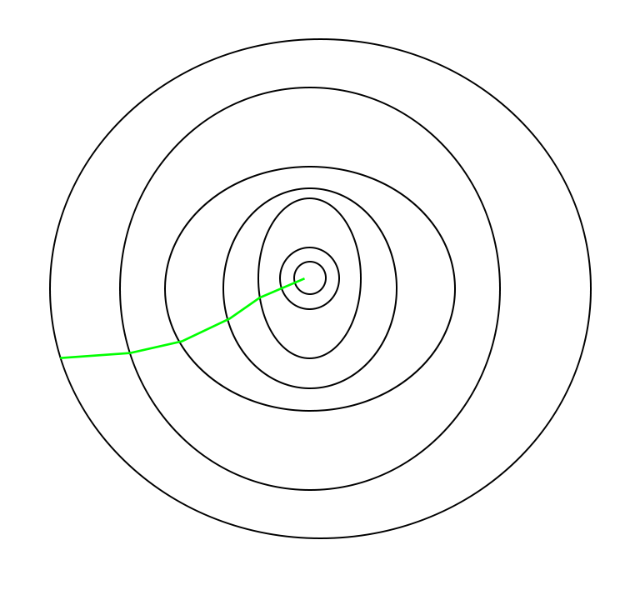
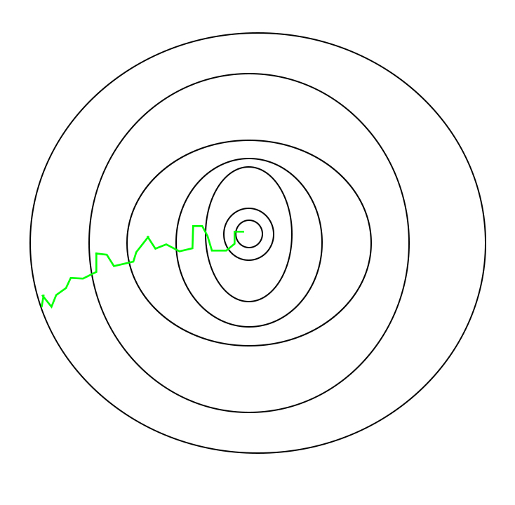
In SGD, since only one sample from the dataset is chosen at random for each iteration, the path taken by the algorithm to reach the minima is usually noisier than your typical Gradient Descent algorithm.
But that doesn’t matter all that much because the path taken by the algorithm does not matter, as long as we reach the minimum and with a significantly shorter training time.
The path taken by Batch Gradient Descent
A path taken by Stochastic Gradient Descent

Slide 54
One thing to be noted is that, as SGD is generally noisier than typical Gradient Descent, it usually took a higher number of iterations to reach the minima, because of the randomness in its descent.
Even though it requires a higher number of iterations to reach the minima than typical Gradient Descent, it is still computationally much less expensive than typical Gradient Descent.
Hence, in most scenarios, SGD is preferred over Batch Gradient Descent for optimizing a learning algorithm.

Slide 55
Advantages of Stochastic Gradient Descent:
Speed: SGD is faster than other variants of Gradient Descent such as Batch Gradient Descent and Mini-Batch Gradient Descent since it uses only one example to update the parameters.
Memory Efficiency: Since SGD updates the parameters for each training example one at a time, it is memory-efficient and can handle large datasets that cannot fit into memory.
Avoidance of Local Minima: Due to the noisy updates in SGD, it has the ability to escape from local minima and converges to a global minimum.

Slide 56
Regression:
Regression is a statistical approach used to analyze the relationship between a dependent variable (target variable) and one or more independent variables (predictor variables).
The objective is to determine the most suitable function that characterizes the connection between these variables.
It seeks to find the best-fitting model, which can be utilized to make predictions or draw conclusions.

Slide 57
Terminologies Related to the Regression Analysis in Machine Learning:
Terminologies Related to Regression Analysis:
Response Variable: The primary factor to predict or understand in regression, also known as the dependent variable or target variable.
Predictor Variable: Factors influencing the response variable, used to predict its values; also called independent variables.
Outliers: Observations with significantly low or high values compared to others, potentially impacting results and best avoided.
Multicollinearity: High correlation among independent variables, which can complicate the ranking of influential variables.
Underfitting and Overfitting: Overfitting occurs when an algorithm performs well on training but poorly on testing, while underfitting indicates poor performance on both datasets.

Slide 58
Linear Regression in Machine Learning
Linear regression is one of the easiest and most popular Machine Learning algorithms. It is a statistical method that is used for predictive analysis. Linear regression makes predictions for continuous/real or numeric variables such as sales, salary, age, product price, etc.
Linear regression algorithm shows a linear relationship between a dependent (y) and one or more independent (y) variables, hence called as linear regression. Since linear regression shows the linear relationship, which means it finds how the value of the dependent variable is changing according to the value of the independent variable.
The linear regression model provides a sloped straight line representing the relationship between the variables.

Slide 59
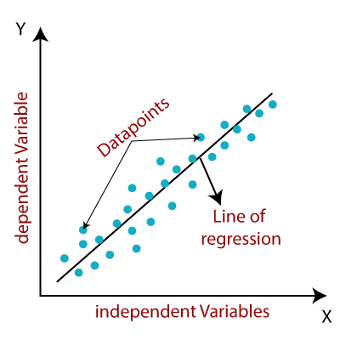

Slide 60
Mathematically, we can represent a linear regression as:
y= a₀+a₁x+ ε
Here,
Y= Dependent Variable (Target Variable) X= Independent Variable (predictor Variable) a0= intercept of the line (Gives an additional degree of freedom) a1 = Linear regression coefficient (scale factor to each input value). ε = random error
The values for x and y variables are training datasets for Linear Regression model representation.

Slide 61
Logistic Regression
Logistic regression is one of the most popular Machine Learning algorithms, which comes under the Supervised Learning technique. It is used for predicting the categorical dependent variable using a given set of independent variables.
Logistic regression predicts the output of a categorical dependent variable. Therefore the outcome must be a categorical or discrete value. It can be either Yes or No, 0 or 1, true or False, etc. but instead of giving the exact value as 0 and 1, it gives the probabilistic values which lie between 0 and 1.
Logistic Regression is much similar to the Linear Regression except that how they are used. Linear Regression is used for solving Regression problems, whereas Logistic regression is used for solving the classification problems.
In Logistic regression, instead of fitting a regression line, we fit an "S" shaped logistic function, which predicts two maximum values (0 or 1).
The curve from the logistic function indicates the likelihood of something such as whether the cells are cancerous or not, a mouse is obese or not based on its weight, etc.
Logistic Regression is a significant machine learning algorithm because it has the ability to provide probabilities and classify new data using continuous and discrete datasets.
Logistic Regression can be used to classify the observations using different types of data and can easily determine the most effective variables used for the classification.

Slide 62

Logistic regression uses the concept of predictive modeling as regression; therefore, it is called logistic regression, but is used to classify samples; Therefore, it falls under the classification algorithm.

Slide 63
Logistic Function (Sigmoid Function):
The sigmoid function is a mathematical function used to map the predicted values to probabilities.
It maps any real value into another value within a range of 0 and 1.
The value of the logistic regression must be between 0 and 1, which cannot go beyond this limit, so it forms a curve like the "S" form. The S-form curve is called the Sigmoid function or the logistic function.
In logistic regression, we use the concept of the threshold value, which defines the probability of either 0 or 1. Such as values above the threshold value tends to 1, and a value below the threshold values tends to 0.

Slide 64
Assumptions for Logistic Regression:
The dependent variable must be categorical in nature.
The independent variable should not have multi-collinearity.
Types of Logistic Regression
On the basis of the categories, Logistic Regression can be classified into three types:
Binomial: In binomial Logistic regression, there can be only two possible types of the dependent variables, such as 0 or 1, Pass or Fail, etc.
Multinomial: In multinomial Logistic regression, there can be 3 or more possible unordered types of the dependent variable, such as “cat”, “dogs”, or “sheep”
Ordinal: In ordinal Logistic regression, there can be 3 or more possible ordered types of dependent variables, such as “low”, “Medium”, or “High”.

Slide 65
Modeling Class Probabilities via Logistic Regression:
Logistic Regression is a statistical method used for modeling the probability of a binary outcome. It's widely employed in various fields, including machine learning and statistics.
The key idea is to transform a linear combination of input features into a value between 0 and 1 using the logistic function (sigmoid function).
This transformed value can be interpreted as the probability of belonging to a particular class.

Slide 66
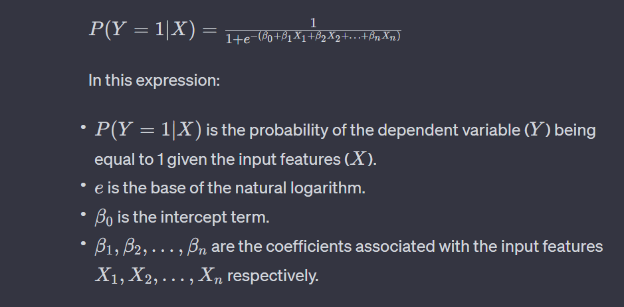
The expression for modeling class probabilities via Logistic Regression can be defined as follows:
The logistic function (sigmoid function) transforms the linear combination of input features and coefficients into a probability value between 0 and 1, making it suitable for binary classification problems.

Slide 67
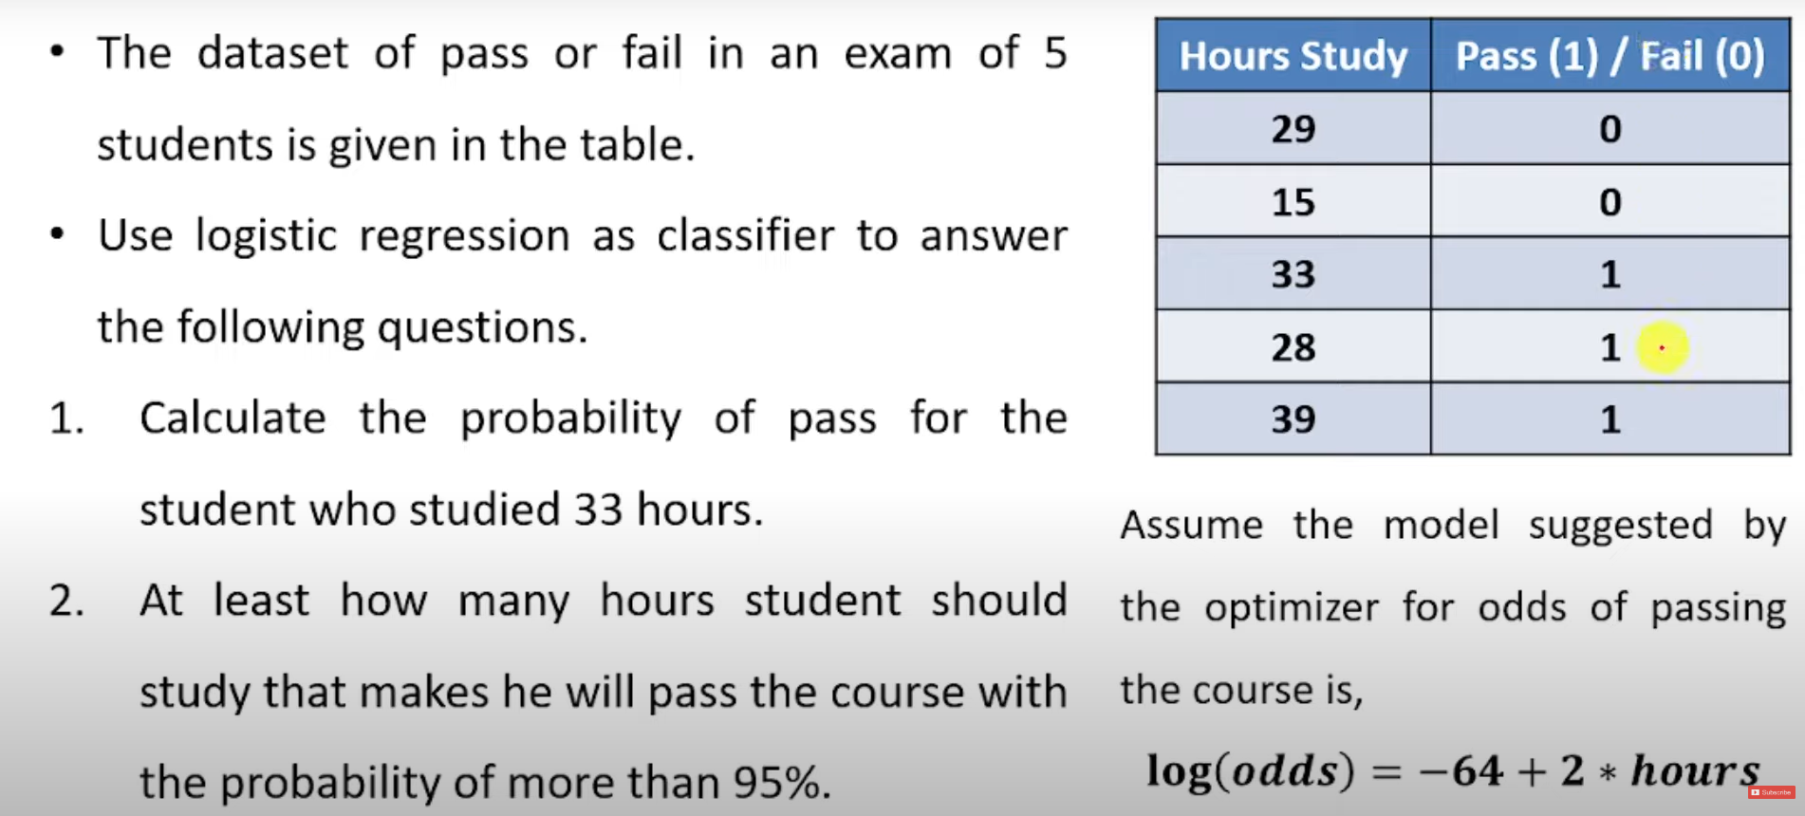
Example:

Slide 68
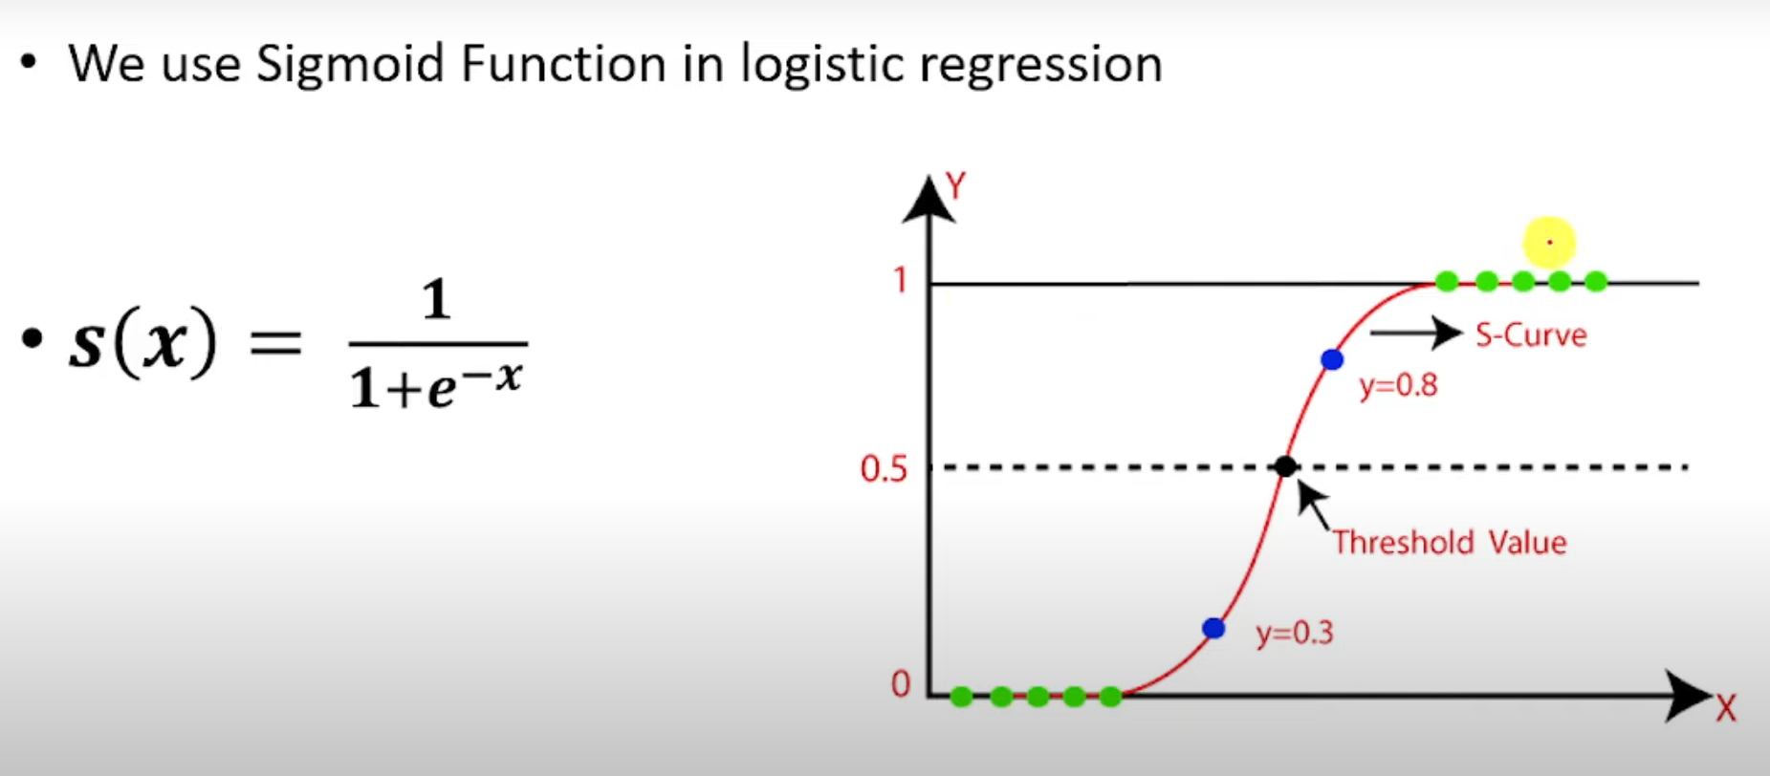

Slide 69
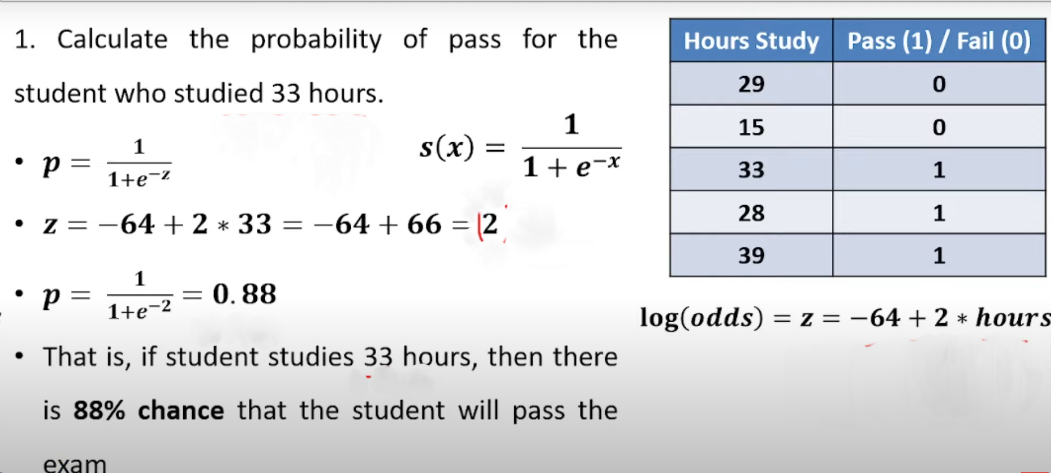

Slide 70
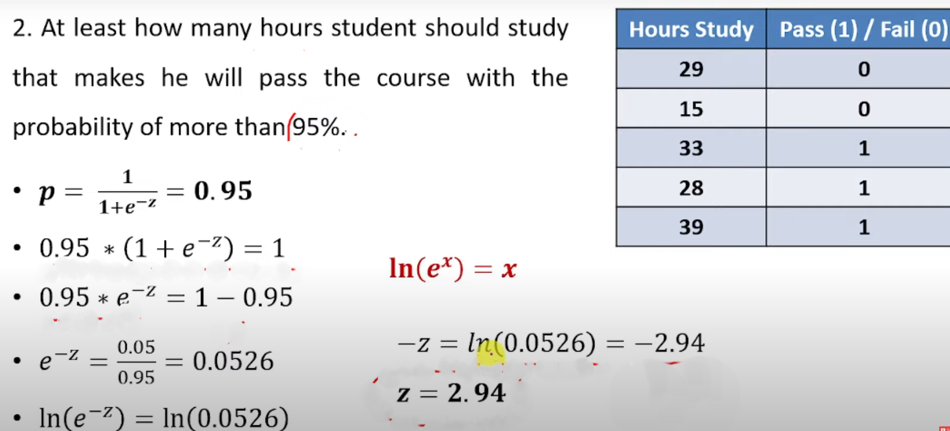

Slide 71
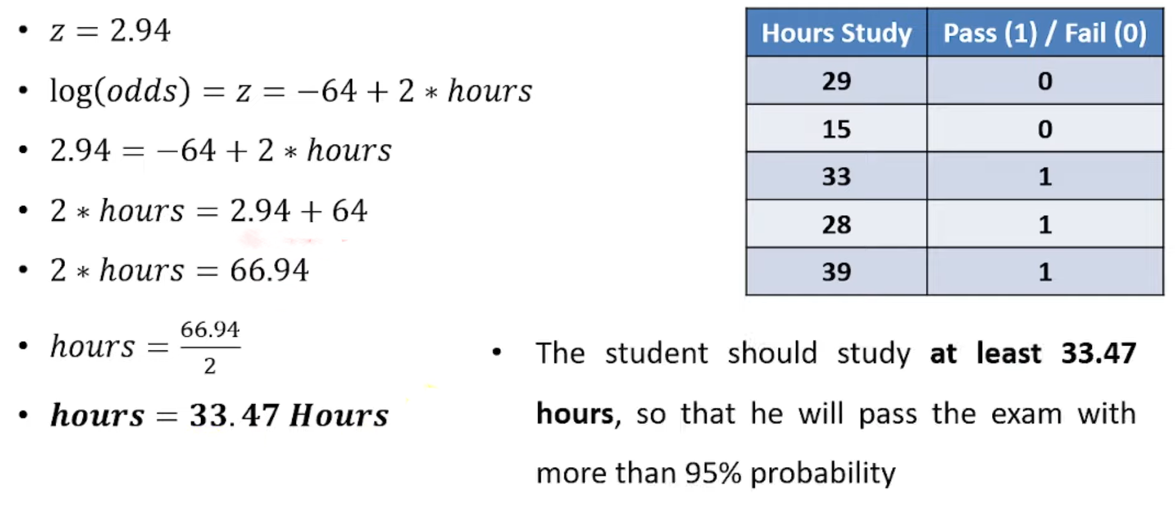

Slide 72
Decision Tree Learning
Decision Tree is a Supervised learning technique that can be used for both classification and Regression problems, but mostly it is preferred for solving Classification problems.
It is a tree-structured classifier, where internal nodes represent the features of a dataset, branches represent the decision rules and each leaf node represents the outcome.
In a Decision tree, there are two nodes, which are the Decision Node and Leaf Node. Decision nodes are used to make any decision and have multiple branches, whereas Leaf nodes are the output of those decisions and do not contain any further branches.

Slide 73


Slide 74
Why use Decision Trees?
There are various algorithms in Machine learning, so choosing the best algorithm for the given dataset and problem is the main point to remember while creating a machine learning model. Below are the two reasons for using the Decision tree:
Decision Trees usually mimic human thinking ability while making a decision, so it is easy to understand.
The logic behind the decision tree can be easily understood because it shows a tree-like structure.

Slide 75
Decision Tree Terminologies:
Root Node: Root node is from where the decision tree starts.
It represents the entire dataset, which further gets divided into two or more homogeneous sets.
Leaf Node: Leaf nodes are the final output node, and the tree cannot be segregated further after getting a leaf node.
Splitting: Splitting is the process of dividing the decision node/root node into sub-nodes according to the given conditions.
Branch/Sub Tree: A tree formed by splitting the tree.
Pruning: Pruning is the process of removing the unwanted branches from the tree.
Parent/Child node: The root node of the tree is called the parent node, and other nodes are called the child nodes.

Slide 76
How does the Decision Tree algorithm Work?
Step-1: Begin the tree with the root node, says S, which contains the complete dataset.
Step-2: Find the best attribute in the dataset using Attribute Selection Measure (ASM).
Step-3: Divide the S into subsets that contains possible values for the best attributes.
Step-4: Generate the decision tree node, which contains the best attribute.
Step-5: Recursively make new decision trees using the subsets of the dataset created in step -3. Continue this process until a stage is reached where you cannot further classify the nodes and called the final node as a leaf node.

Slide 77
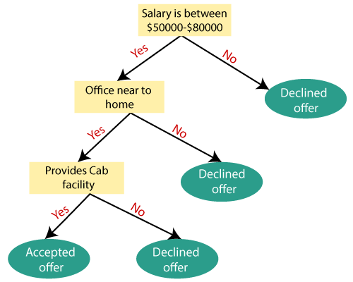
Example: Suppose there is a candidate who has a job offer and wants to decide whether he should accept the offer or Not. So, to solve this problem, the decision tree starts with the root node (Salary attribute by ASM). The root node splits further into the next decision node (distance from the office) and one leaf node based on the corresponding labels. The next decision node further gets split into one decision node (Cab facility) and one leaf node. Finally, the decision node splits into two leaf nodes (Accepted offers and Declined offer). Consider the below diagram:

Slide 78
Attribute Selection Measures
While implementing a Decision tree, the main issue arises that how to select the best attribute for the root node and for sub-nodes. So, to solve such problems there is a technique which is called as Attribute selection measure or ASM. By this measurement, we can easily select the best attribute for the nodes of the tree. There are two popular techniques for ASM, which are:
Information Gain
Gini Index

Slide 79
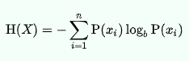
Information Gain:
Information gain is the measurement of changes in entropy after the segmentation of a dataset based on an attribute.
It calculates how much information a feature provides us about a class.
According to the value of information gain, we split the node and build the decision tree.
A decision tree algorithm always tries to maximize the value of information gain, and a node/attribute having the highest information gain is split first. It can be calculated using the below formula:
Information Gain= Entropy(S)- [(Weighted Avg) *Entropy(each feature)
Entropy: Entropy is a metric to measure the impurity in a given attribute. It specifies randomness in data.

Slide 80
Pruning: Getting an Optimal Decision tree
Pruning is a process of deleting the unnecessary nodes from a tree in order to get the optimal decision tree.
A too-large tree increases the risk of overfitting, and a small tree may not capture all the important features of the dataset. Therefore, a technique that decreases the size of the learning tree without reducing accuracy is known as Pruning.

Slide 81
Iterative Dichotomizer 3 (ID3):
It is a top down greedy approach, meaning that the root will be created first, and that the algorithm optimizes locally at each iteration.

Slide 82
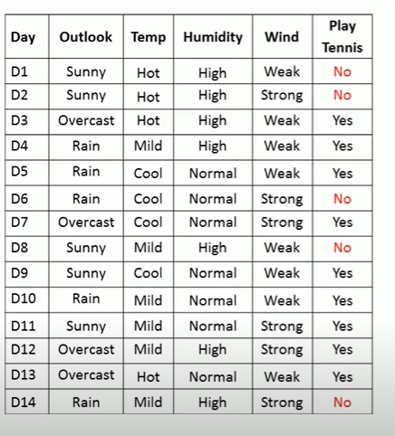
Example:

Slide 83
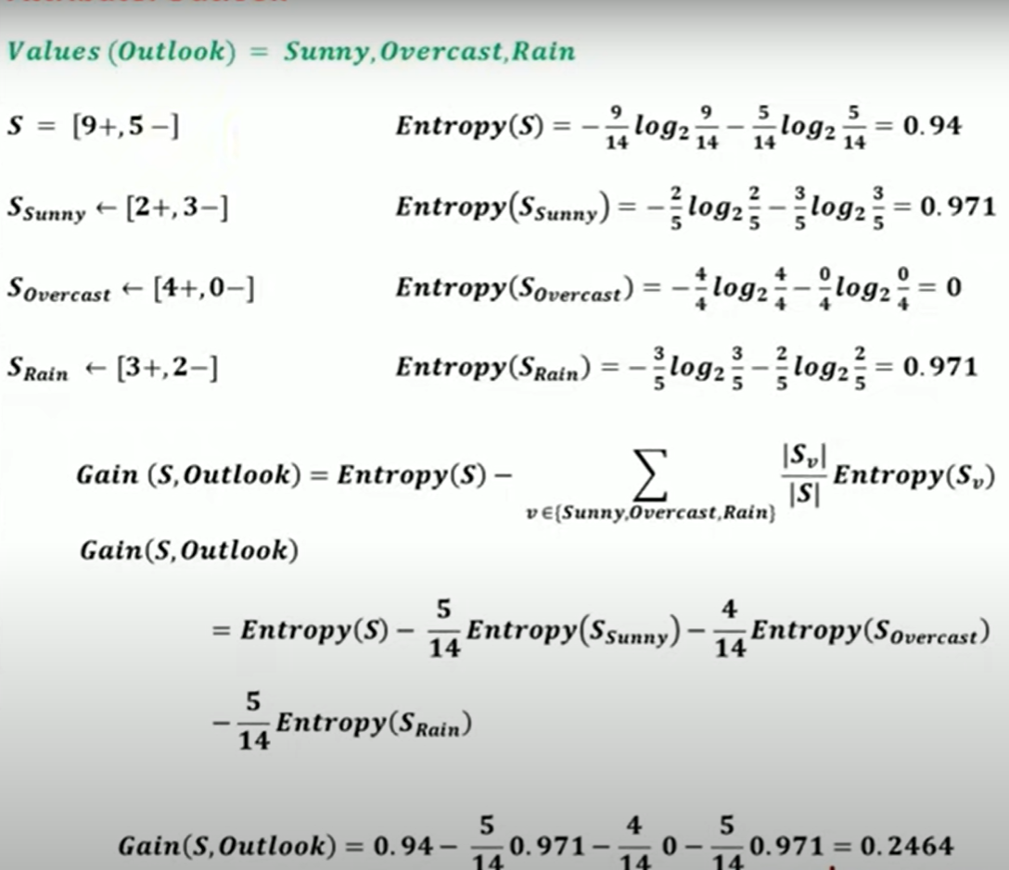
Attribute: Outlook

Slide 84
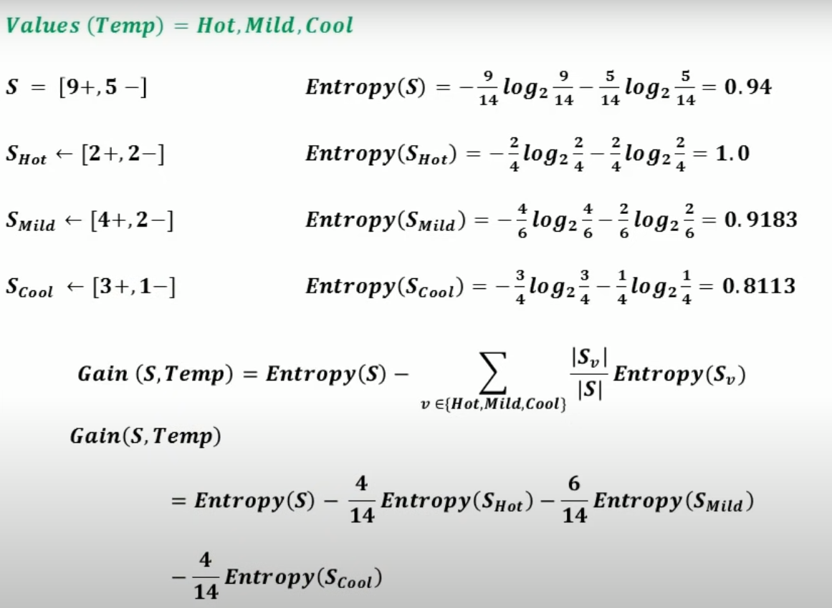
Attribute: temp
Gain(S, Temp)= 0.0289

Slide 85
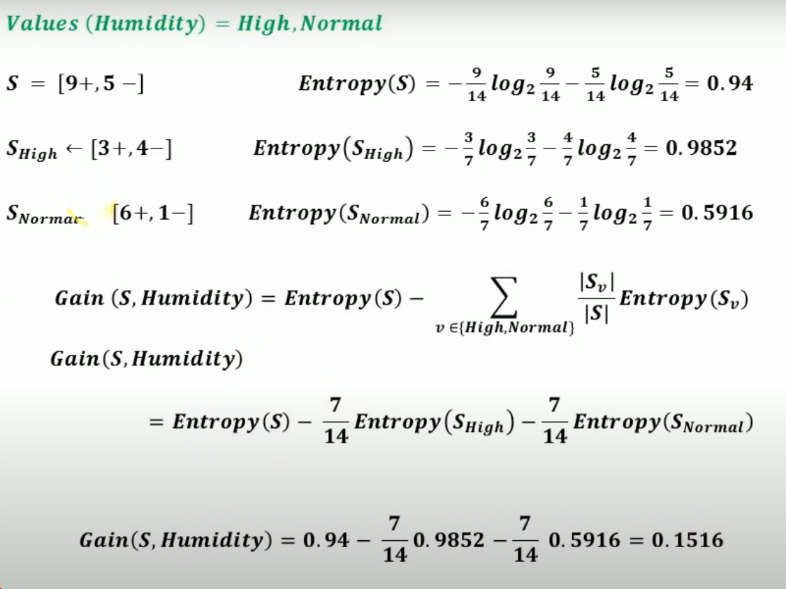
Attribute: Humidity

Slide 86
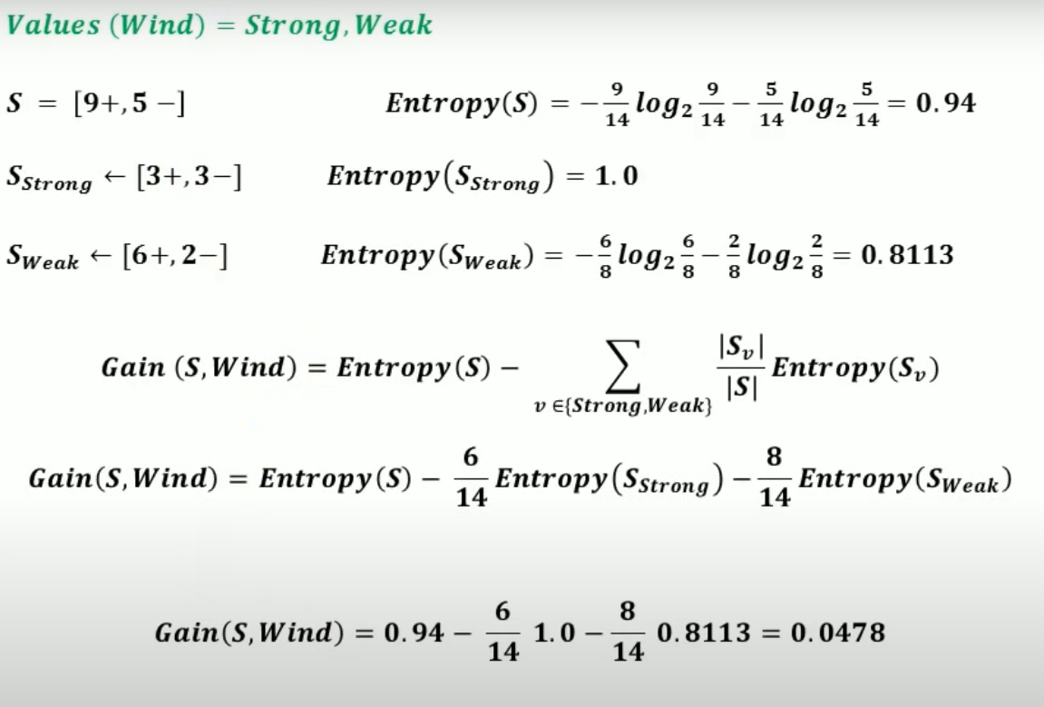
Attribute: Wind

Slide 87
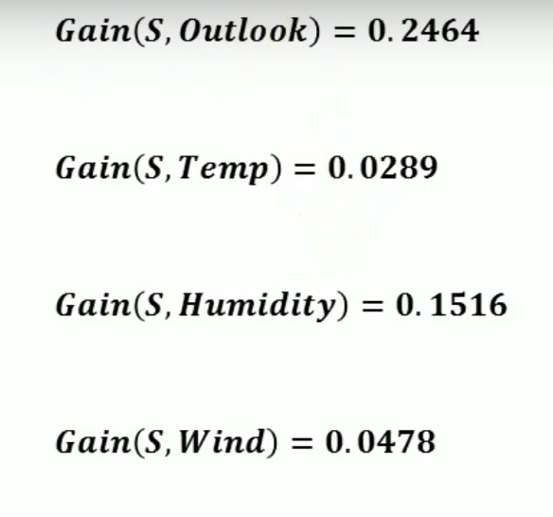
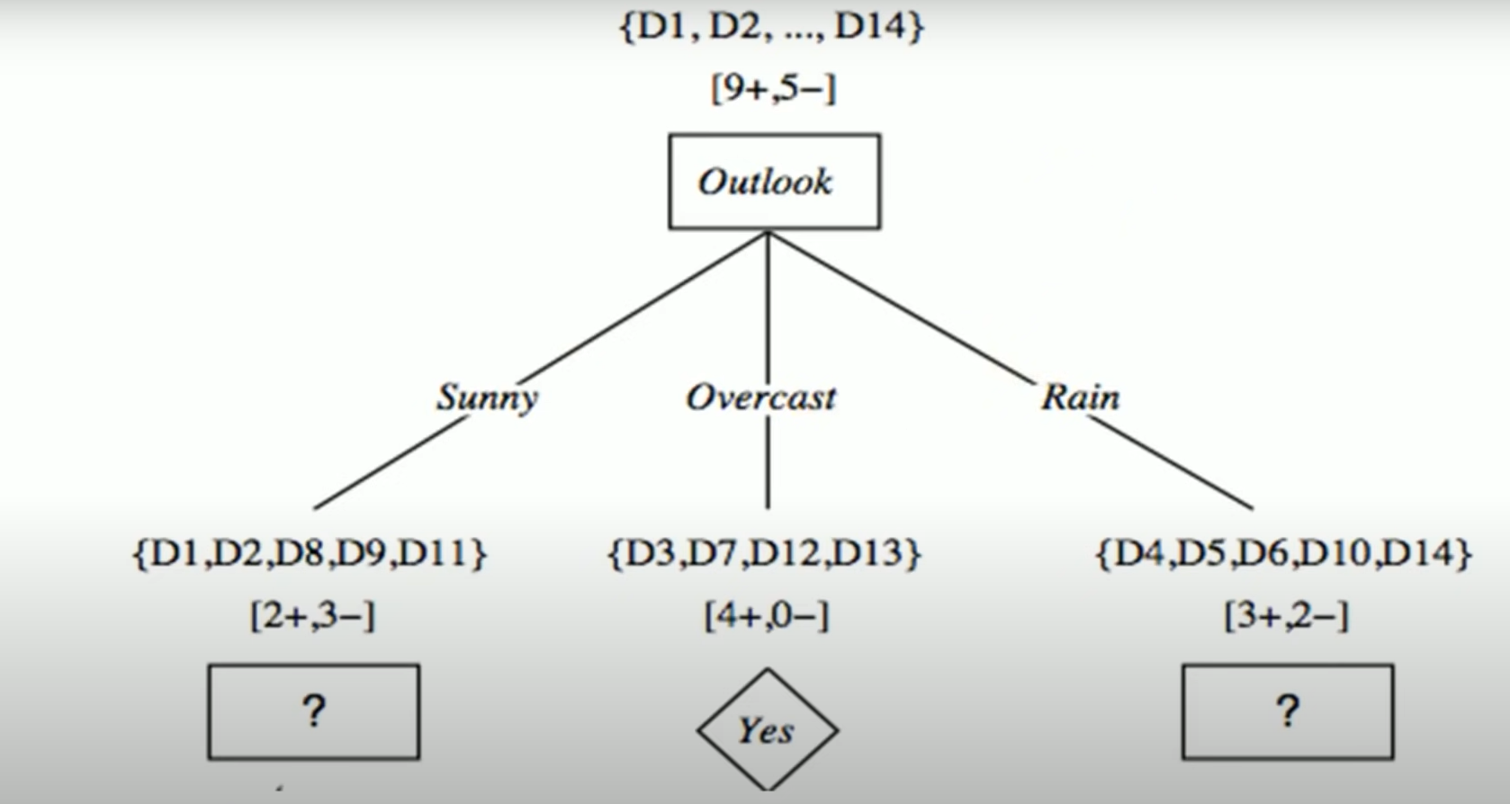
Maximum gain is for Outlook, so consider Outlook as root node.

Slide 88
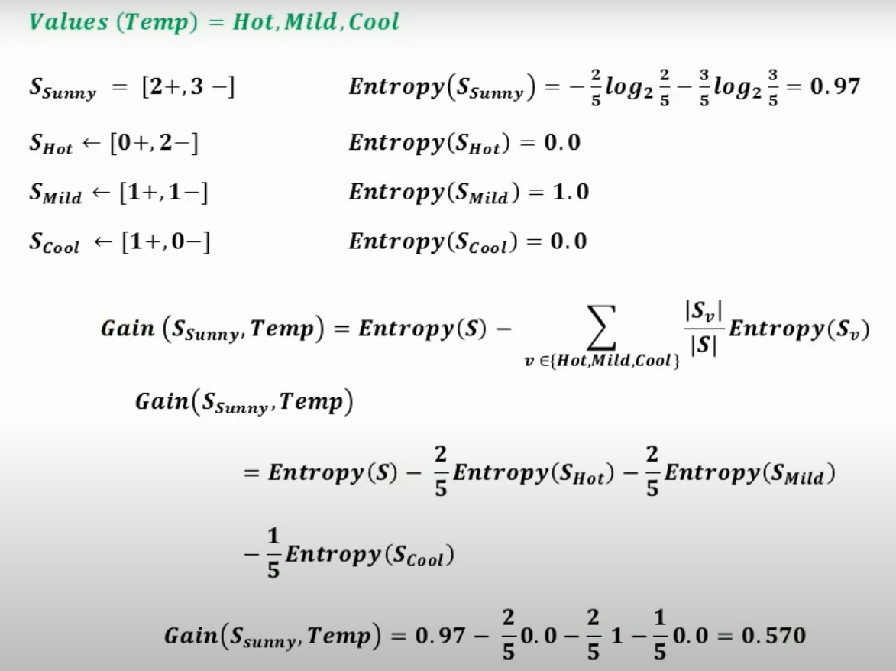
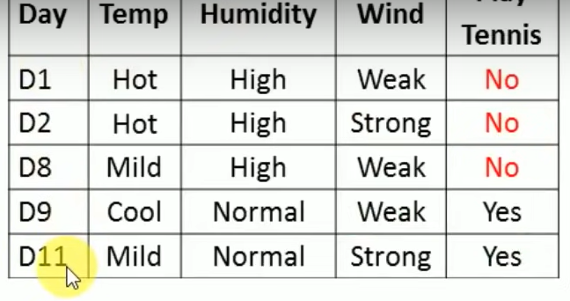
Attribute: Temp

Slide 89
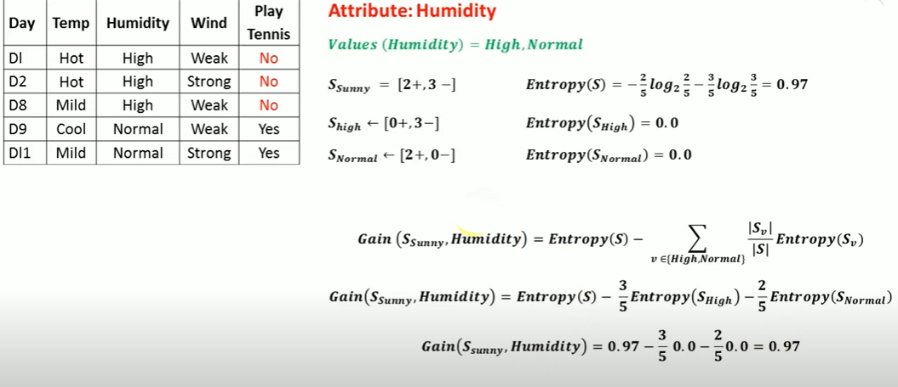

Slide 90
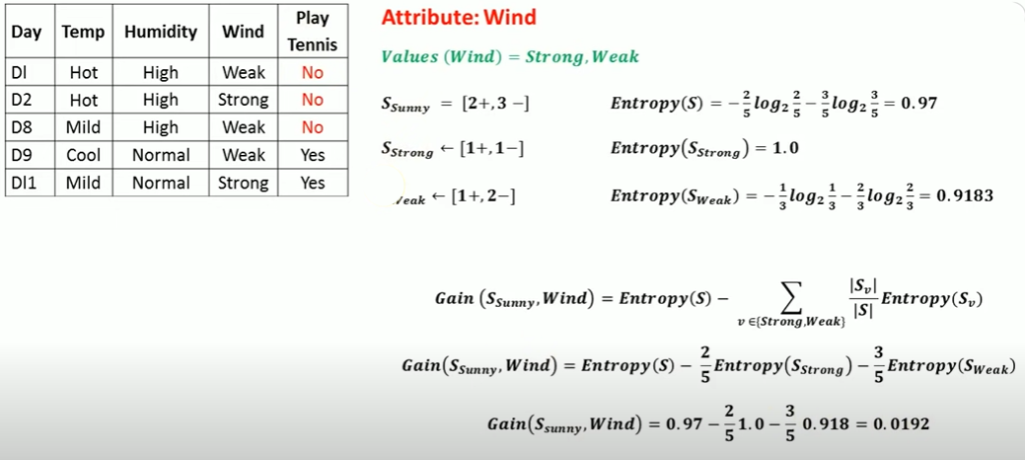

Slide 91
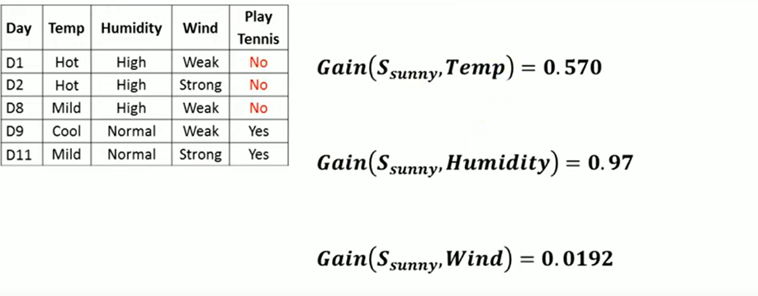

Slide 92
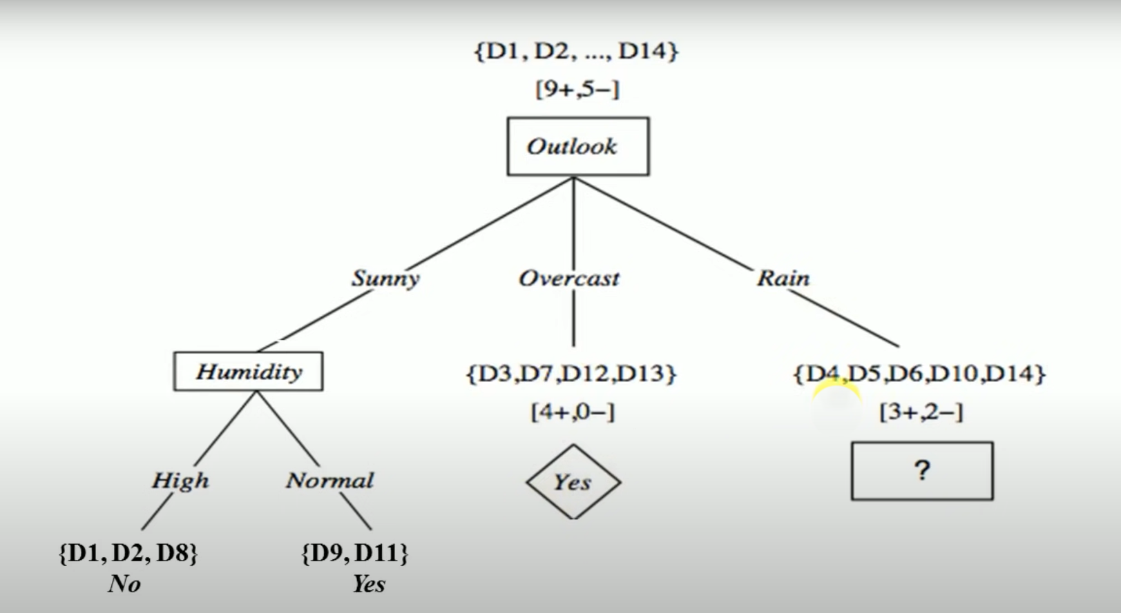

Slide 93
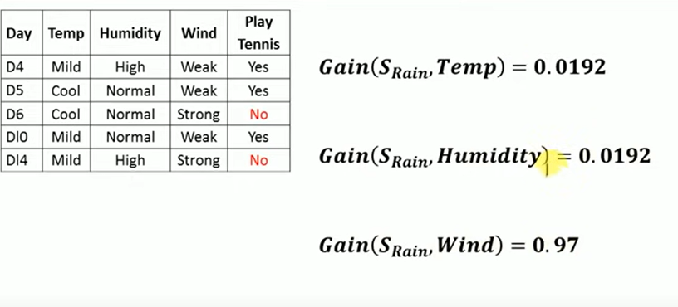

Slide 94
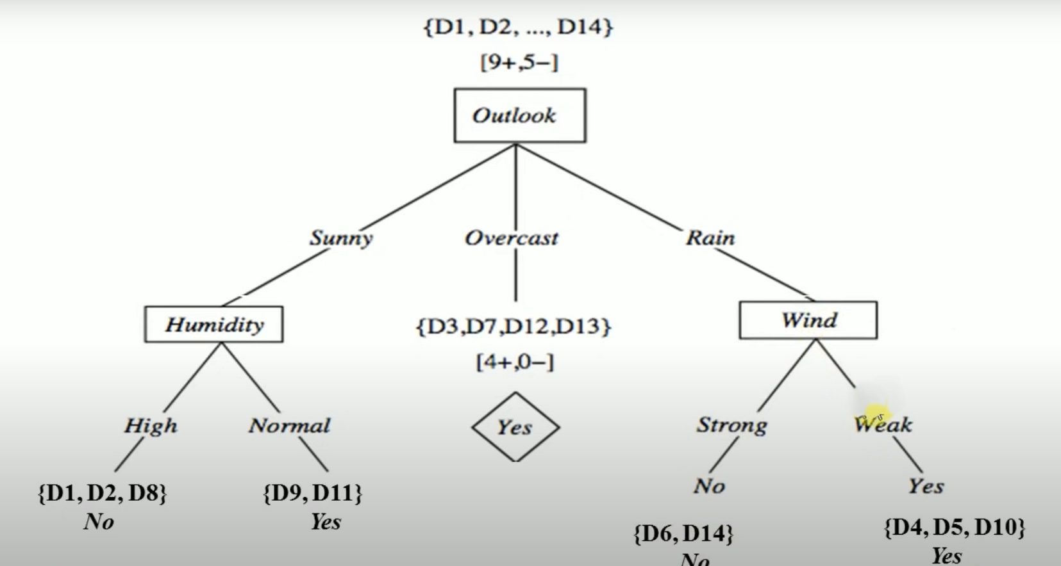

Slide 95
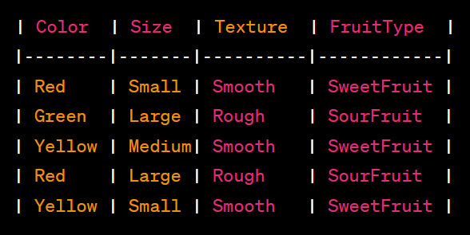
Task:

Slide 96
CART:
CART is a predictive algorithm used in Machine learning and it explains how the target variable’s values can be predicted based on other matters. It is a decision tree where each fork is split into a predictor variable and each node has a prediction for the target variable at the end.
The term CART serves as a generic term for the following categories of decision trees:
Classification Trees: The tree is used to determine which “class” the target variable is most likely to fall into when it is continuous.
Regression trees: These are used to predict a continuous variable’s value.

Slide 97
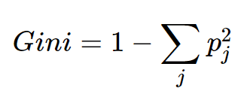
Gini Index:
Gini index is a measure of impurity or purity used while creating a decision tree in the CART(Classification and Regression Tree) algorithm.
An attribute with the low Gini index should be preferred as compared to the high Gini index.
It only creates binary splits, and the CART algorithm uses the Gini index to create binary splits.

Slide 98
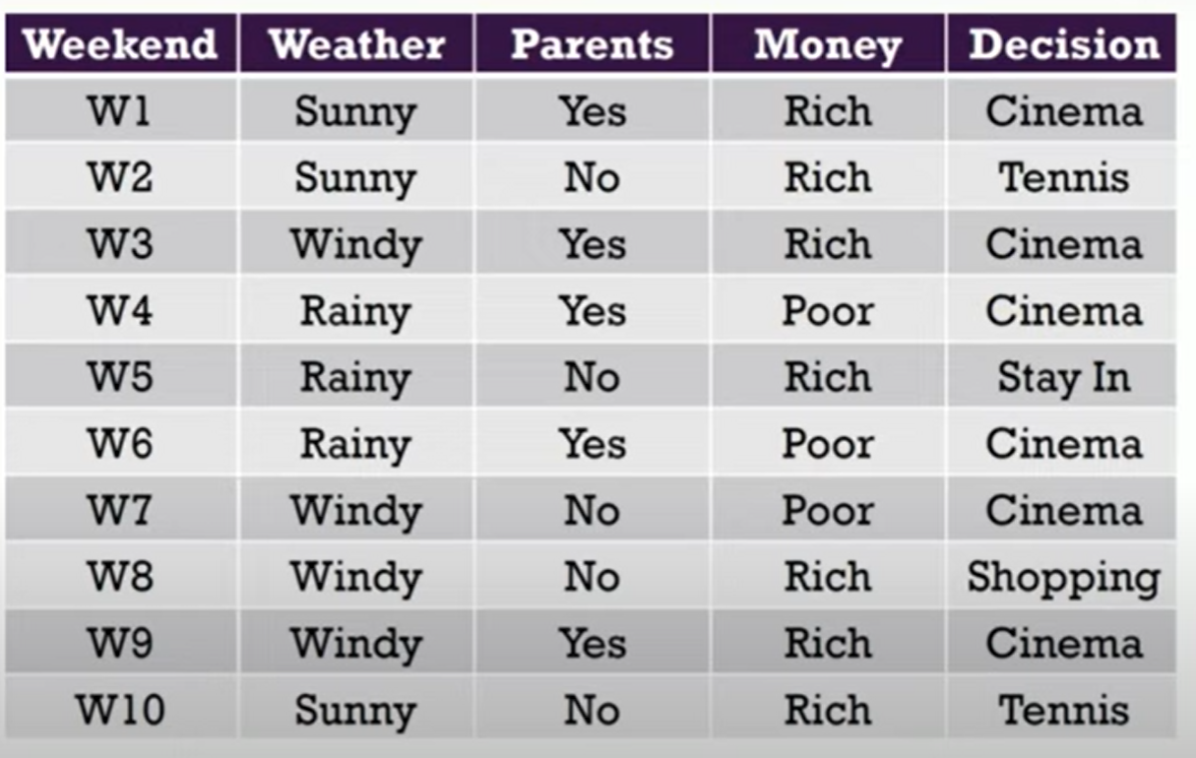
Example:

Slide 99
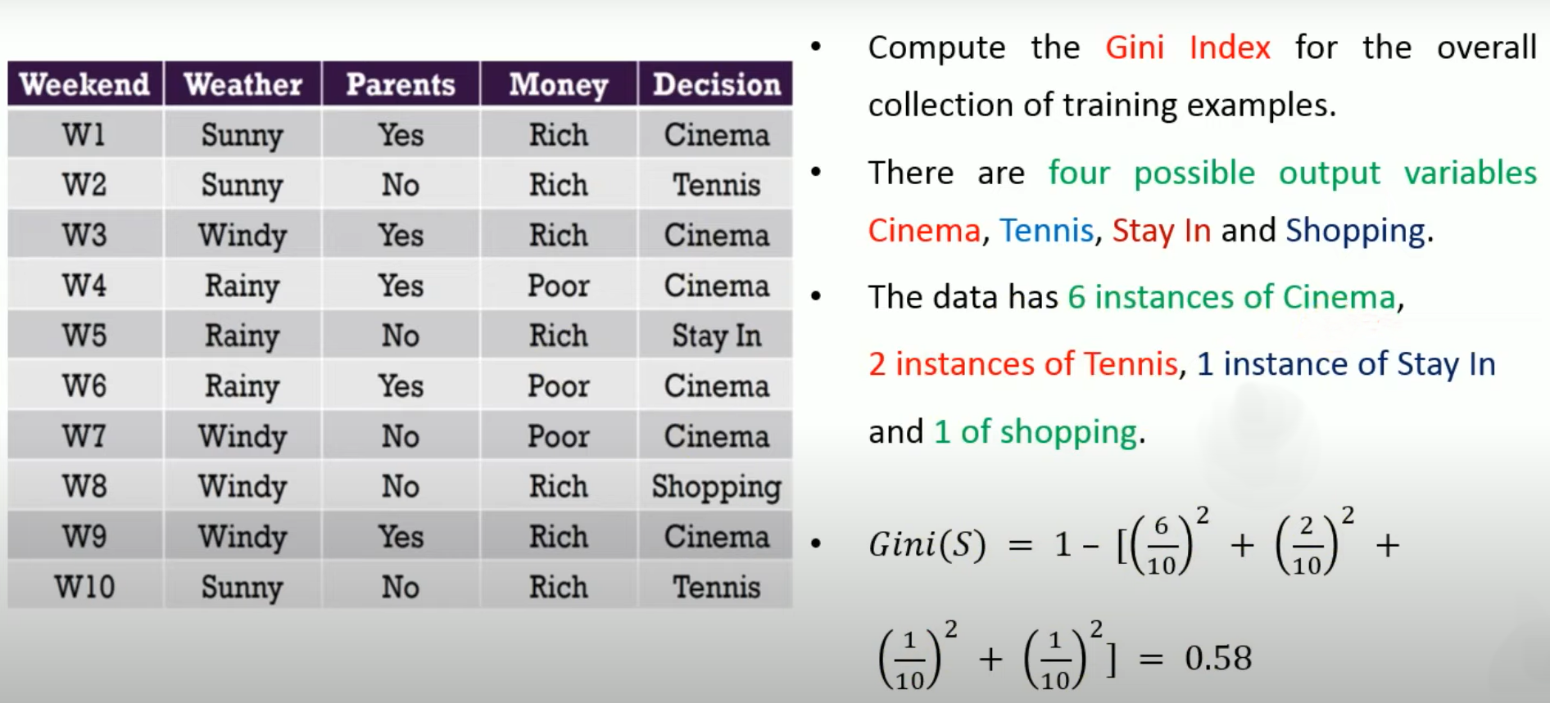
Compute Gini index of overall dataset:

Slide 100
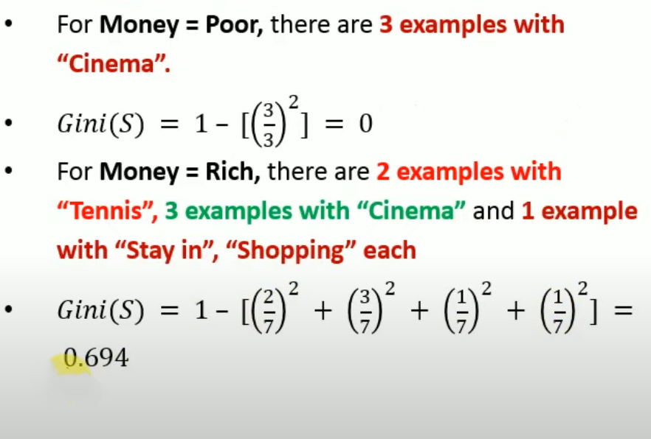
Gini index of Money attribute:
It has two possible values Rich and Poor. 7 instances of Rich and 3 instances of Poor.

Slide 101
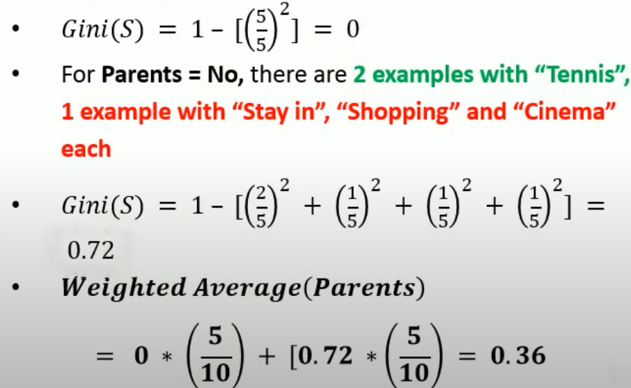
Gini index of Parent attribute:
Parent attribute have two possible values Yes(5 Instances) and No (5 Instances).
For Parents=Yes, there are 5 instances, all with “Cinema”.

Slide 102
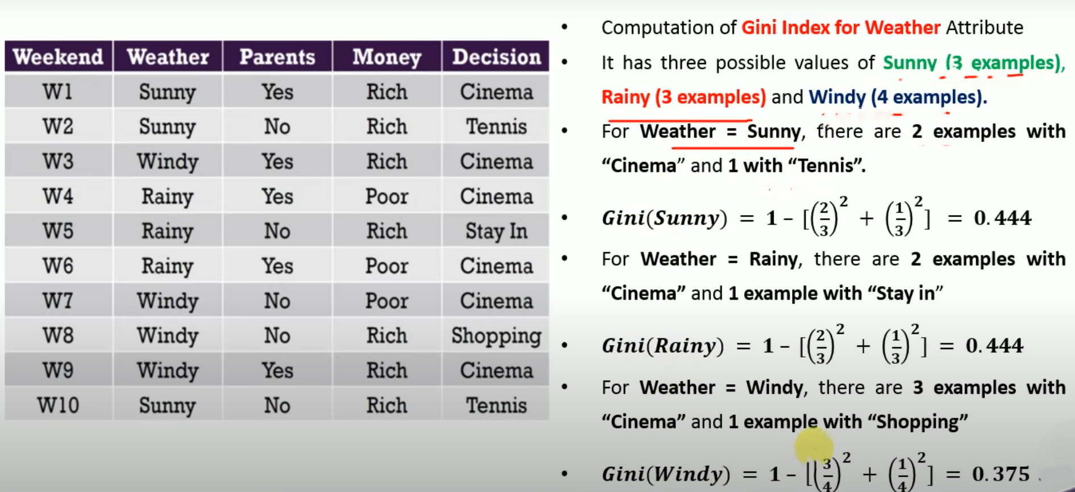
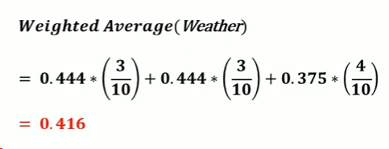
Gini index for weather attribute:

Slide 103
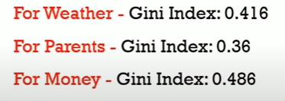
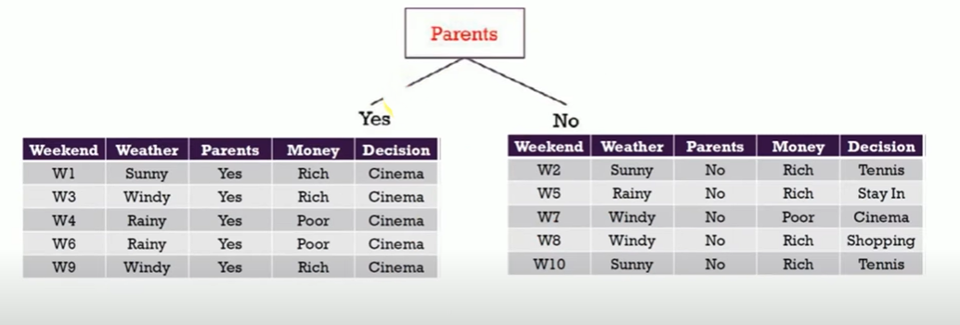
Select the Attribute which has minimum Gi ni index ad root node:

Slide 104
Again calculate Gini index, where Parent=NO

Slide 105
Thank you!

